Slide 1
Chapter 4 Blockchain 3.0
Dr. Nilesh M. Patil

Slide 2
Introduction
Blockchain 3.0 refers to the evolution of blockchain technology beyond its initial use case in cryptocurrencies (Blockchain 1.0) and smart contracts (Blockchain 2.0).
It typically involves advancements such as scalability, interoperability, and improved consensus algorithms to enable a wider range of applications and enhance blockchain's practicality and efficiency.
It uses directed acyclic graphs (DAGs) as a data structure to process transactions. DAGs enable the unidirectional flow of information, eliminating the need for block times and allowing transactions to be processed instantly. This remarkable speed enables Blockchain 3.0 to process an astonishing 10,000 transactions per second, which surpasses the rate of traditional financial institutions such as Visa.
Blockchain 3.0 enhances the security of sensitive information in healthcare, logistics, and even voting systems, allowing for greater transparency and accessibility while tightening security.

Slide 3
Features of Blockchain 3.0
Some key features of Blockchain 3.0 include,
1. Interoperability: Blockchain 3.0 allows different blockchain networks to communicate and share data, enabling cross-chain transactions and interoperability between dApps.
2. Scalability: Blockchain 3.0 aims to overcome the scalability issues of earlier versions of blockchain technology by incorporating solutions such as sharding, side chains, and off-chain transactions.
3. Privacy: Blockchain 3.0 introduces new privacy features such as zero-knowledge proofs, ring signatures, and stealth addresses. It enables users to maintain anonymity while transacting on the blockchain.
4. Advanced Smart Contracts: Blockchain 3.0 allows for more complex and sophisticated contracts, enabling a wider range of dApps.
5. Governance: Blockchain 3.0 introduces new mechanisms for decentralized governance. It allows stakeholders to participate in decision-making and helps ensure blockchain networks remain decentralized and secure.
6. Sustainability: Blockchain 3.0 incorporates new consensus mechanisms that are more environmentally sustainable than earlier versions.

Slide 4
Examples of Blockchain 3.0 Projects
Some examples of blockchain 3.0 include,
1. EOS
EOS is a blockchain platform that aims to provide a highly scalable and flexible infrastructure for decentralized applications (dApps).
It uses a Delegated Proof-of-Stake (DPoS) consensus algorithm, which is faster and more efficient than traditional algorithms like Proof-of-Work (PoW) and Proof-of-Stake (PoS).
2. Cardano
Cardano is a blockchain platform that uses a unique consensus algorithm called Ouroboros. It aims to provide a highly secure and scalable infrastructure for dApps and smart contracts.
Cardano also incorporates a treasury system that allows stakeholders to vote on allocating funds for development initiatives.
3. Polkadot
Polkadot is a blockchain platform that aims to provide interoperability between different blockchains. It uses a unique sharding architecture to process multiple transactions simultaneously.
Polkadot also incorporates a governance mechanism that allows stakeholders to vote on important decisions related to the platform.

Slide 5
Introduction to Hyperledger
“Hyperledger is an open-sourced community of communities to benefit an ecosystem of Hyperledger based solution providers and users focused on blockchain related use cases that will work across a variety of industrial sectors.“ – Brian Behlendorf, Executive Director of Hyperledger.
Hyperledger is an open-source collaborative effort created to advance cross-industry blockchain technologies.
It is not a specific blockchain or cryptocurrency, but rather a collection of blockchain frameworks, tools, and libraries that are designed to provide developers with a starting point for building robust, enterprise-grade blockchain solutions.
The project is managed by the Linux Foundation and is supported by a global community of developers and contributors who work together to improve the performance, scalability, and security of blockchain technology.

Slide 6
Why is Hyperledger Necessary?
Public blockchains do not support private and confidential transactions.
Public blockchain is having issues with scalability.
During rigorous testing, developers involved realized that in blockchain networks, where every peer needs to validate each and every transaction and run consensus at the same time, take a huge blow in terms of scalability.
Above that, transactions with a measure of confidentiality and privacy attached to them cannot be executed on public blockchains due to the exhaustive measures that are taken to ensure the integrity of a transaction.

Slide 7
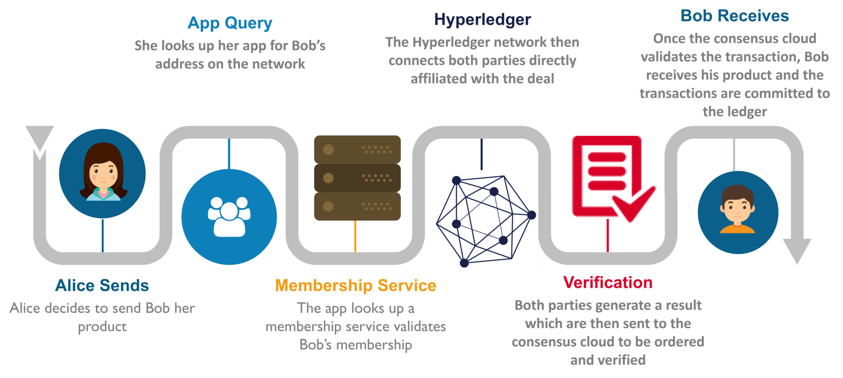
Hyperledger Transaction
,

Slide 8
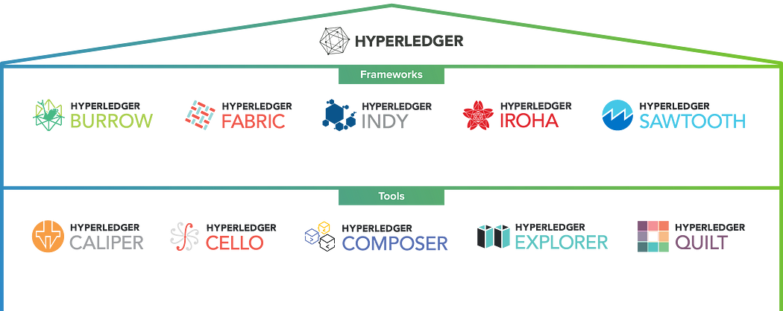
Hyperledger Frameworks and Tools

Slide 9
Hyperledger Frameworks
Hyperledger Fabric, used extensively in supply-chain networks
Hyperledger Sawtooth, is being used in the fishing industry to track the journey of fishes
Hyperledger Burrow, which is being used to run Ethereum smart contracts in a Hyperledger network
Hyperledger Iroha, finds usage in mobile application optimization with the help of blockchain
Hyperledger Indy, is being used as a decentralized identity database service for businesses

Slide 10
Hyperledger Tools
Caliper — It is a performance benchmark tool for blockchain platforms/implementation. It uses the predefined set of use cases to evaluate.
Cello — It is an on-demand, deploy “as a service” tool to reduce the complexity of deploying the platforms and applications.
Composer — It is a simplified tool to develop blockchain networks, smart contracts, and permission for the Hyperledger Fabric Blockchain platform.
Explorer — It is an explorer for the Blockchain network to view Transactions, Blocks, etc.
Quilt — It is a tool that can be used to build interoperability between Hyperledger projects or traditional applications using the ILP protocols.
Ursa — Shared cryptographic library for better security and reusability of cryptographic standards across projects and applications.

Slide 11
Bitcoin Vs Ethereum Vs Hyperledger
Parameters | Bitcoin | Ethereum | Hyperledger
Cryptocurrency | Bitcoin | Ether | None; can be implemented if deemed necessary
Network | Public | Public | Permissioned
Consensus | Proof of Work (SHA26) | Ethash | Practical Fault Byzantine Tolerance
Smart Contract | None | Yes (solidity) | Yes (chaincode)
Language | c++ | golang/java | golang/python

Slide 12
Hyperledger Fabric
Hyperledger Fabric is an open source, permissioned blockchain framework, started in 2015 by The Linux Foundation.
It is a modular, general-purpose framework that offers unique identity management and access control features, which make it suitable for a variety of industry applications such as track-and-trace of supply chains, trade finance, loyalty and rewards, as well as clearing and settlement of financial assets.
It provide high levels of secrecy, robustness, adaptability, and scalability.

Slide 13
How Does Hyperledger Fabric Work?
A Hyperledger Fabric network is comprised of unique organizations (or members) that interact with each other on the network. For example, an organization could be a bank in a network comprised of financial institutions or a shipping partner in a supply chain network.
From a Fabric component perspective, each organization has a Fabric certificate authority and one or more peer nodes.
A Fabric network also has an ordering service shared by all organizations in the network, and this component helps process transactions for the network.
An organization in a network is defined by a root certificate specific to that organization.
Users and other components (like peer nodes) in that organization are also identified by certificates, and these certificates are derived from this root certificate, ensuring other organizations in the network can relate a user to their organization. These certificates also specify the permissions for each entity on the network, like read-only versus full access on a channel.
A root certificate for an organization is stored in the Fabric certificate authority (CA). The Fabric CA also issues certificates for users in an organization and handles other related operations. An enterprise-grade Fabric CA utilizes a variety of components and can deployed in a variety of ways using a Hardware Security Module (HSM) for root certificate protection.
An organization also creates one or more peer nodes as components to carry out operations on behalf of that organization.
Specifically, a peer node endorses transactions proposed on the network, stores and executes smart contract code (known as chaincode in Fabric), and stores a local copy of the ledger for access.
Fabric clients typically interact with peer nodes to read the ledger, add new chaincode to the network, or propose a new transaction. A peer node typically runs on its own computer, like an Amazon EC2 instance.
Finally, a Fabric network also includes of an ordering service shared by all members of the network. The ordering service makes sure new transactions on the network are properly ordered in new blocks and have the proper endorsements. The ordering service then broadcasts a new block of transactions to peer nodes in each organization.
Peer nodes update their local copy of the ledger with this new block.

Slide 14
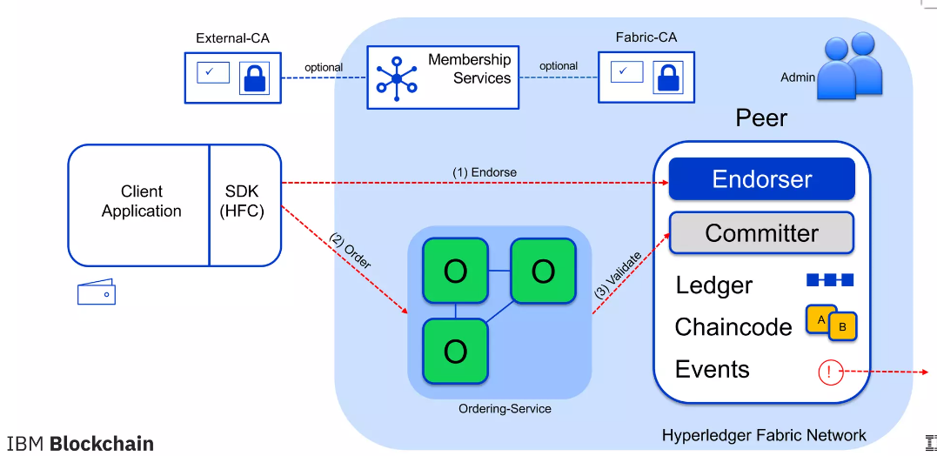
Hyperledger Fabric Architecture

Slide 15
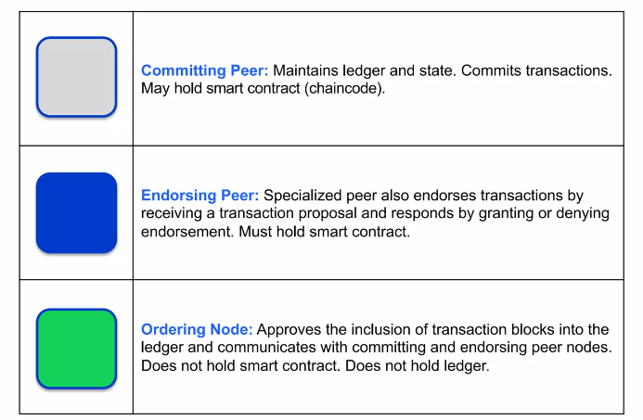
Nodes and Roles

Slide 16
Components of Hyperledger Fabric System
There is a notion of networks in Hyperledger Fabric allowing member companies to join and interact.
A channel is a tunnel via which one organization can interact surreptitiously with other organizations that have joined the same channel.
Others who do not participate in the channel in issue will never have access to any of the channel's transactions or data.
The critical components in the Hyperledger Fabric System are as follows:
Assets
Chaincode
Ledger
Security
Consensus

Slide 17
Assets
Assets can range from tangible to intangible.
Hyperledger Fabric allows users to change holdings by using the chain code transaction procedure.
Assets are represented as a sequence of key-value pairs in the Hyperledger Fabric system, with transitions being recorded as trades on a ledger route.
Assets are represented in binary and JSON formats.

Slide 18
Chaincode
Chaincode actions begin with a transaction concept and are then tested against the ledger's current state data.
Additionally, Chaincode implementation provides a set of key-value entries that may be transmitted to the network and applied to all users' logs.

Slide 19
Ledger
All modifications in the Fabric's value are documented in a damage-resistant, chronological ledger.
Every operation creates a set of asset key-value pairs in the ledger, generated, modified, or removed.

Slide 20
Security
Hyperledger Fabric is the backbone of a distributed transaction processing system in which all participants are recognized.
Cryptographic licenses are associated with enterprises, networking devices, app developers or client applications using Public Key Infrastructure.
As a result, data access control may be governed and monitored at the network and channel levels, providing safety.

Slide 21
Consensus
Consensus comprises more than merely reacting to transaction execution, as evidenced by its prominent role in the whole operation pipeline in Hyperledger Fabric, from demand and authorization to scheduling, validation, and pledge.
In a nutshell, consensus refers to the complete verification of the integrity of a block's transactions.

Slide 22
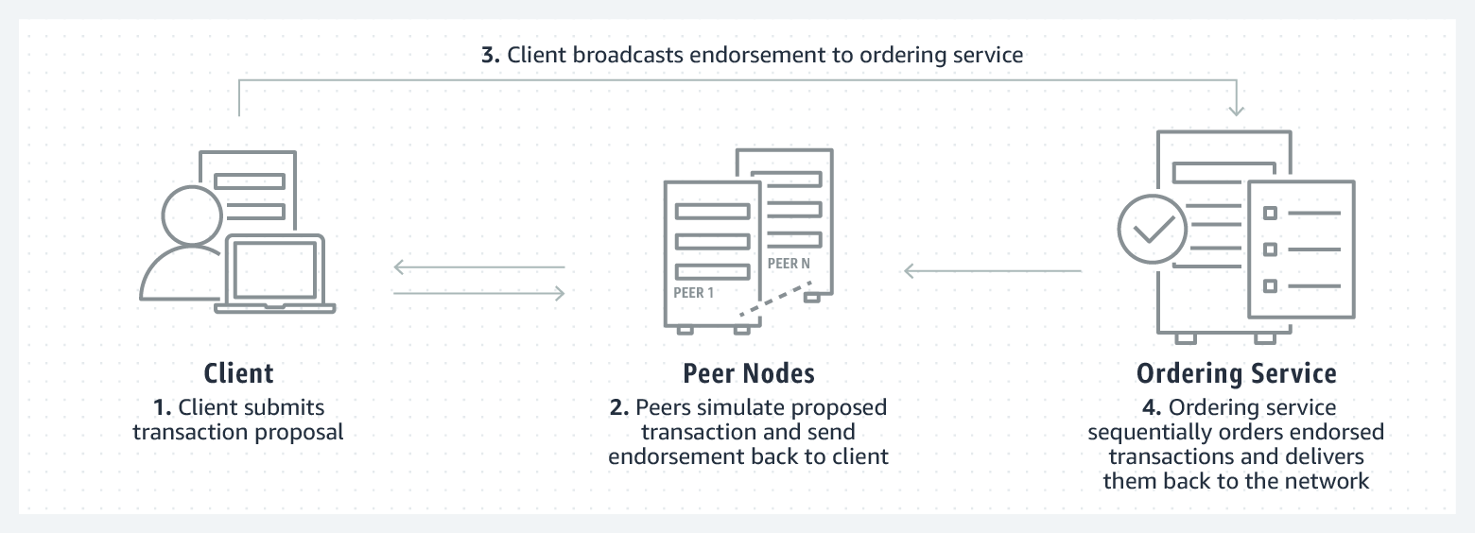
Hyperledger Fabric Transaction Flow
https://blog.clairvoyantsoft.com/hyperledger-fabric-transaction-flow-c6bcc2142b5a

Slide 23
Hyperledger Fabric Transaction Flow
1. The transaction flow begins when a client application sends a transaction proposal to peers in each organization for endorsement.
2. The peers verify the submitting client’s identity and authority to submit the transaction. Next, they simulate the outcome of the proposed transaction and if it matches what was expected, it sends an endorsement signature back to the client.
3. The client collects endorsements from peers, and once it receives the proper number of endorsements defined in the endorsement policy, it sends the transaction to the ordering service.
4. Lastly, the ordering service checks to see if the transaction has the proper number of endorsements to satisfy the endorsement policy. It then chronologically orders and packages the approved transactions into blocks, and sends these blocks to peer nodes in each organization. Peer nodes receive new blocks of transactions from the ordering service, and then do a final validation for transactions in that block. Once this is complete, the new block is added to the ledger and the state of the ledger is updated. The new transactions are now committed.

Slide 24
Benefits of Hyperledger Fabric
Network With Authorization: Instead of an open network of anonymous participants, establish decentralized confidence in a web of known members.
Transactions Are Private: Only share the info you want with the people you want.
Architecture Is Pluggable: Rather than a one-size-fits-all strategy, tailoring the blockchain to industry demands a pluggable design.
Starting-up Is Simple: Instead of learning proprietary languages and architectures, smart program contracts in the languages your team uses. The number of trust levels and verification is minimized, which keeps the network and processing clean.
Access, Control and Governance: Fabric networks are composed of channels that are a private ‘subnet’ of communication between different or more specified users on the web, allowing them to interact securely and secretly.

Slide 25
Hyperledger Fabric vs. Hyperledger Sawtooth
CHARACTERISTICS | HYPERLEDGER FABRIC | HYPERLEDGER SAWTOOTH
Permissions | Created specifically for permissioned networks. | Supports permissioned and permissionless networks.
Privacy and Network Governance | Provide complete data isolation between a set of participants. Strict network governance enabled by the Hyperledger Fabric certificate authority (CA), and channels. | All network peers have access to all transaction data. Does not provide channels or certificate authority (CA) capabilities.
Transaction Flow | Unique Execute-Order-Commit endorsement model where transactions are initially executed on a set of peers while ordering service handles packaging and delivery. Flexibility in defining set of required endorsers at the data level or contract level. This approach makes the framework more scalable and prevents nondeterminism in contract code. | Traditional Order-Execute-Commit flow. Sawtooth Validator handles transaction processing, ordering, and delivery.
Consensus Algorithms | Pluggable consensus algorithm allowing the orderer to be switched based on needs of the environment. Amazon Managed Blockchain's ordering service is built using Amazon QLDB technology and has an immutable change log that accurately maintains the complete history of all transactions in the blockchain network, ensuring durability of the data. | Uses a default “Proof-of-Elapsed Time (PoET)” algorithm, which is a Byzantine Fault consensus mechanism that relies on a specialized hardware component.
Smart Contract Language | Go, Java, Node.js | Go, Java, Python, Rust

Slide 26
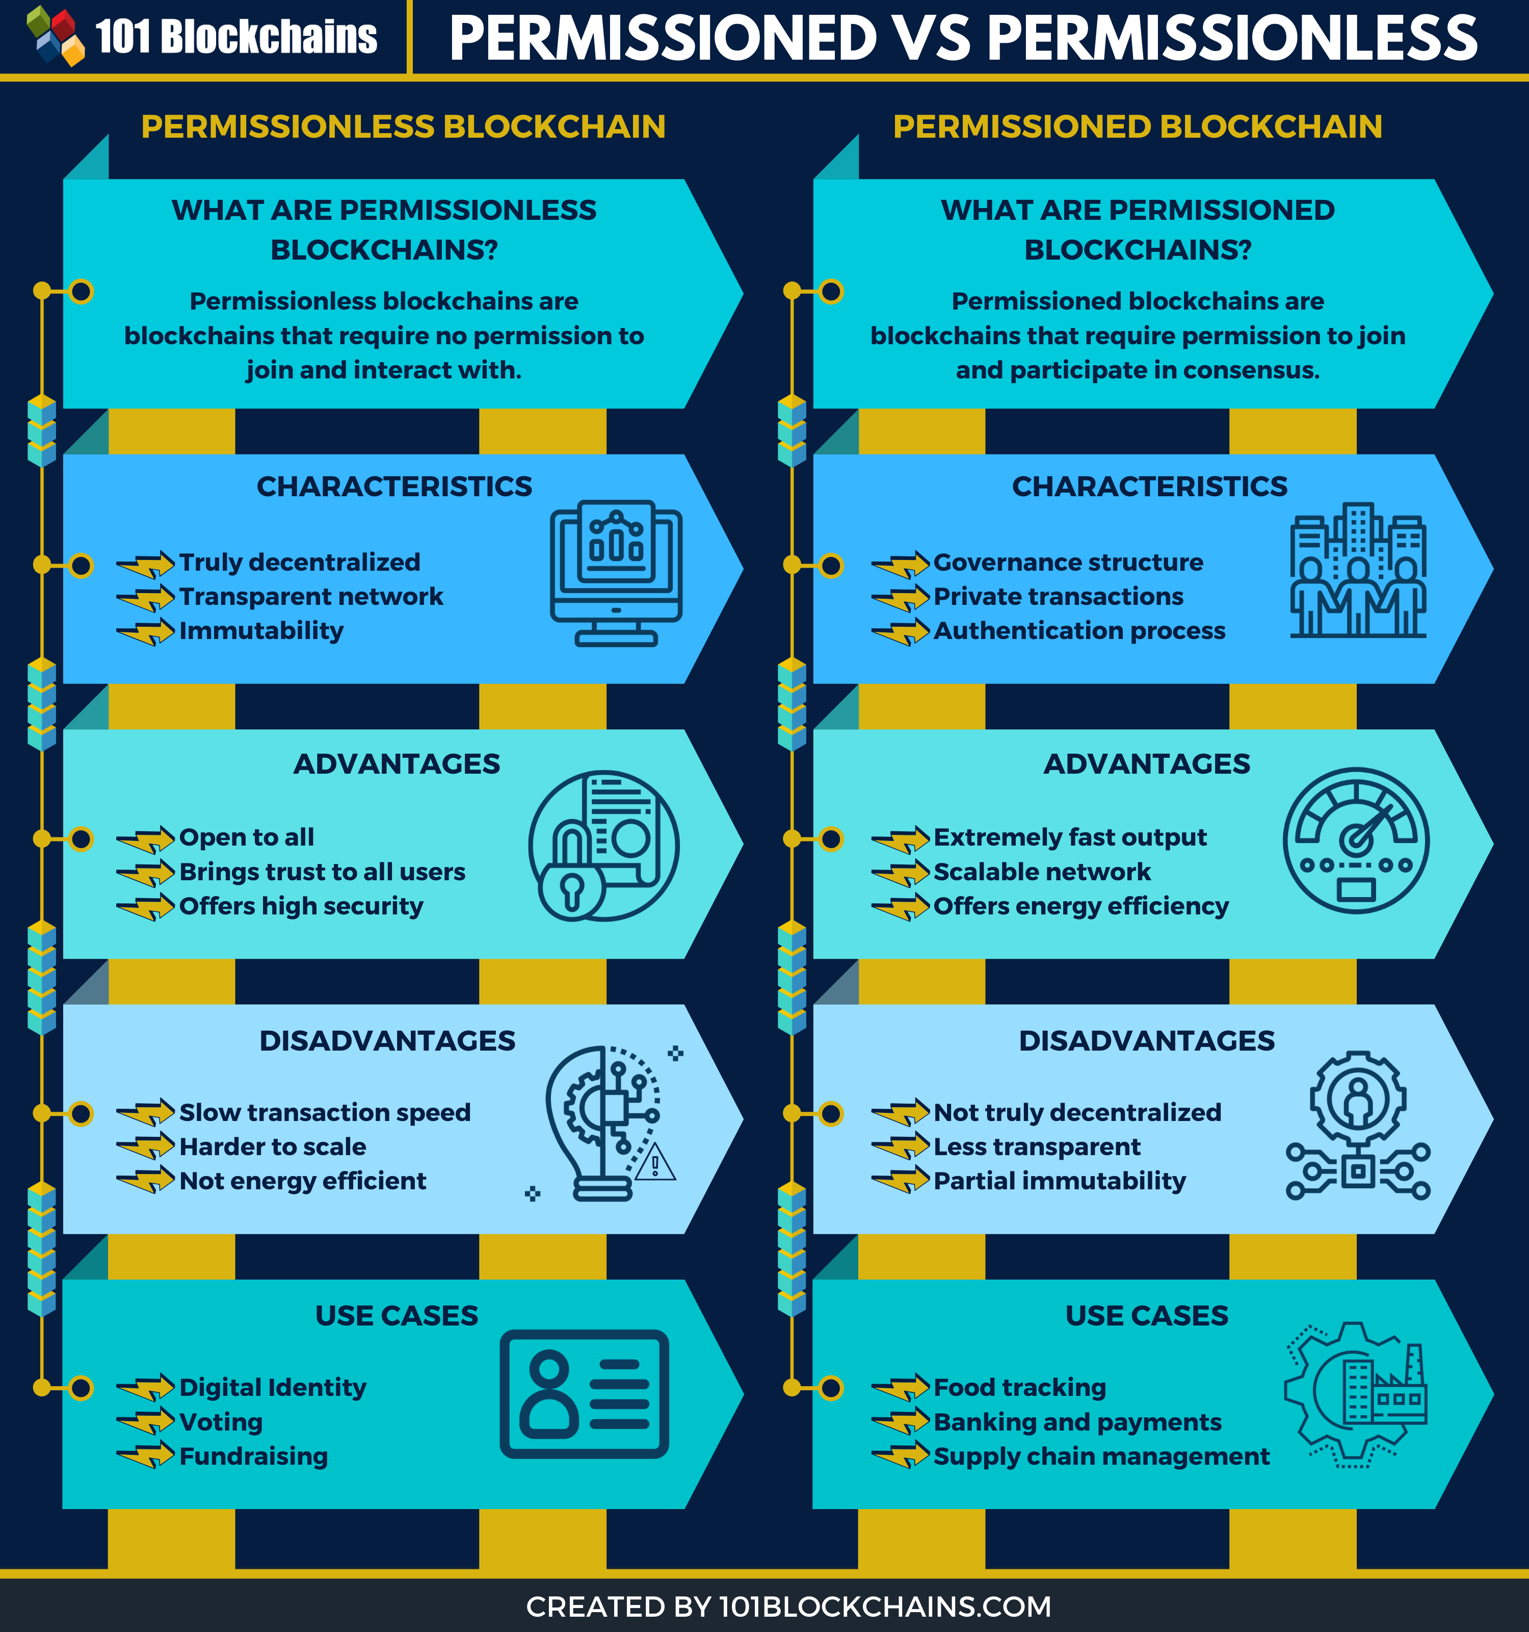

Slide 27
Microsoft Azure’s Blockchain As A Service (BAAS)
Azure Blockchain Service is a fully managed ledger service that gives users the ability to grow and operate blockchain networks at scale in Azure, via unified control for both infrastructure management as well as blockchain network governance.
It provides the following:
Simple network deployment and operations
Consortium management
Smart contracts with development tools
It provides support for the Ethereum Quorum ledger using the Istanbul Byzantine Fault Tolerance (IBFT) consensus mechanism.

Slide 28
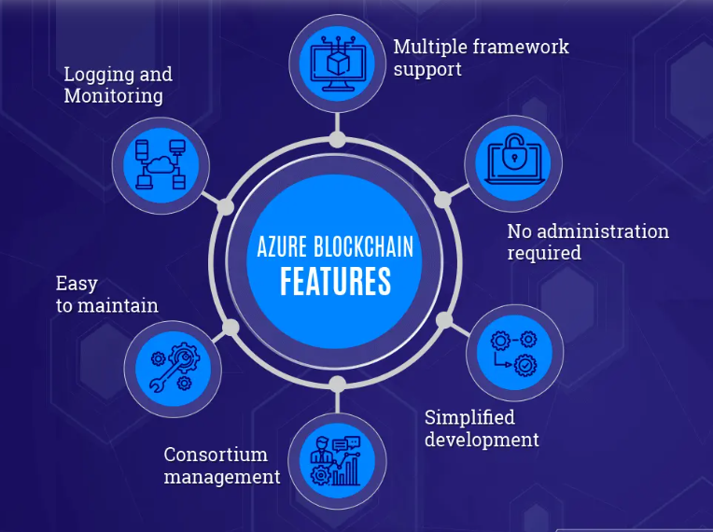
Features of Microsoft Azure’s Blockchain

Slide 29
Features of Microsoft Azure’s Blockchain
Multiple Framework Support: Azure Blockchain Services comes with the support of four prominent Azure blockchain frameworks, including the Quorum, Ethereum, Corda, and Hyperledger Fabric. These frameworks are also not limited, there will be more “Azure Blockchain Framework.”
No Administration Required: Azure manages all the backend tools and infrastructure for managing the blockchain network.
Simplified Deployment: It is easy to deploy Azure blockchain service through the available blockchain tools such as the Azure CLI, Azure portal. Even the Visual Studio code has been updated to support the Azure Blockchain extension, which makes it easier for the developer to create blockchain-related apps. Other than that, it is also accessible to provisioning validator and transaction nodes. Moreover, you can also manage the security and the storage of Azure Virtual Networks.

Slide 30
Features of Microsoft Azure’s Blockchain
Security: All the transaction and validator nodes are protected using firewall rules. As the owner, you need to configure the firewall before you can access them. Also, data encryption is provided for all the transaction nodes. It is done via TLS. On top of it, you can also add basic authentication, add more firewall rules, or even add access keys.
Maintenance: The nodes are also maintained to ensure that they run with the latest version of the Blockchain. Azure BaaS is a managed service, and hence everything is managed by the Azure themselves.
Consortium management: The consortium blockchain management is baked within the Azure Blockchain. With it, you get full access to the consortia. You also get full node management and the ability to add or remove members. Other key features supported by the consortium management include simplified policy enforcement and codeless permissioning.
Monitoring and logging: The monitoring feature is fully developed. Here, you will get tons of rich metrics to monitor your blockchain environment. It is managed by Azure Monitor Service, where you can get information about nodes storage, CPU, memory, and other important metrics, including transaction queue depth, blocks mined, and so on!

Slide 31
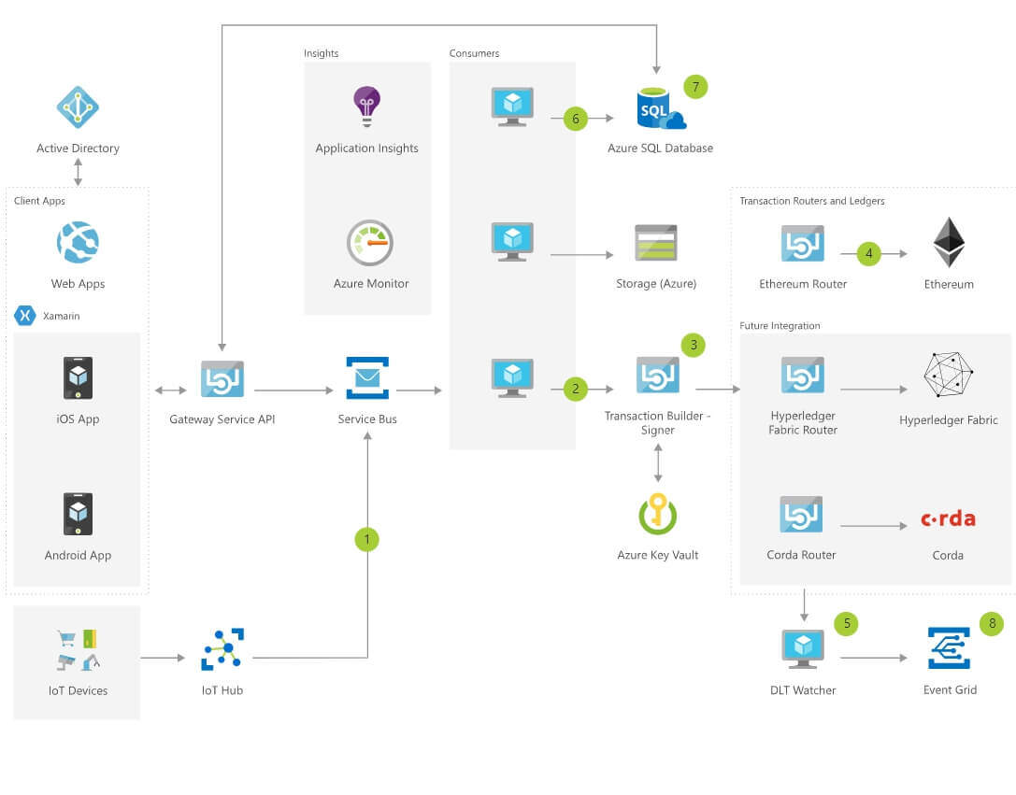
Azure Blockchain Workbench Architecture

Slide 32
Azure Blockchain Workbench Architecture
Identity and authentication
Using Blockchain Workbench, a consortium can federate their enterprise identities using Azure Active Directory (Azure AD).
The identity mapping facilitates authenticated login to client APIs and applications and uses the authentication policies of organizations.
Workbench also provides the ability to associate enterprise identities to specific roles within a given smart contract. In addition, Workbench also provides a mechanism to identify the actions those roles can take and at what time.
After Blockchain Workbench is deployed, users interact with Blockchain Workbench either via the client applications, REST-based client API, or Messaging API.
Users federate their identities to a consortium Azure AD by sending an email invitation to participants at their email address.
When logging in, these users are authenticated using the name, password, and policies. For example, two-factor authentication of their organization.
Azure AD is also used to assign users to a special administrator group.
Users associated with the administrator group are granted access to rights and actions within Blockchain Workbench including deploying contracts and giving permissions to a user to access a contract.
Users outside this group do not have access to administrator actions.

Slide 33
Azure Blockchain Workbench Architecture
Client applications
Workbench provides automatically generated client applications for web and mobile (iOS, Android), which can be used to validate, test, and view blockchain applications.
The application interface is dynamically generated based on smart contract metadata and can accommodate any use case.
The client applications deliver a user-facing front end to the complete blockchain applications generated by Blockchain Workbench.
In the web application, authorized users can access the Administrator Console.
The console is available to users in the Administrator group in Azure AD and provides access to the following functionality:
Deploy Microsoft provided smart contracts for popular scenarios. For example, an asset transfer scenario.
Upload and deploy their own smart contracts.
Assign a user access to the smart contract in the context of a specific role.

Slide 34
Azure Blockchain Workbench Architecture
Gateway service API
Blockchain Workbench includes a REST-based gateway service API.
When writing to a blockchain, the API generates and delivers messages to an event broker.
When data is requested by the API, queries are sent to the off-chain SQL database.
The SQL database contains a replica of on-chain data and metadata that provides context and configuration information for supported smart contracts.
Queries return the required data from the off-chain replica in a format informed by the metadata for the contract.
Developers can access the gateway service API to build or integrate blockchain solutions without relying on Blockchain Workbench client apps.

Slide 35
Azure Blockchain Workbench Architecture
Message broker for incoming messages
Developers who want to send messages directly to Blockchain Workbench can send messages directly to Service Bus.
For example, messages API could be used for system-to-system integration or IoT devices.
Message broker for downstream consumers
During the lifecycle of the application, events occur. Events can be triggered by the Gateway API or on the ledger.
Event notifications can initiate downstream code based on the event.
Blockchain Workbench automatically deploys two types of event consumers.
One consumer is triggered by blockchain events to populate the off-chain SQL store. The other consumer is to capture metadata for events generated by the API related to the upload and storage of documents.

Slide 36
Azure Blockchain Workbench Architecture
Message consumers: Message consumers take messages from Service Bus. The underlying eventing model for message consumers allows for extensions of additional services and systems. For example, you could add support to populate CosmosDB or evaluate messages using Azure Streaming Analytics. The following sections describe the message consumers included in Blockchain Workbench.
Distributed ledger consumer: Distributed ledger technology (DLT) messages contain the metadata for transactions to be written to the blockchain. The consumer retrieves the messages and pushes the data to a transaction builder, signer, and router.
Database consumer: The database consumer takes messages from Service Bus and pushes the data to an attached database, such as SQL database.
Storage consumer: The storage consumer takes messages from Service Bus and pushes data to an attached storage. For example, storing hashed documents in Azure Storage.

Slide 37
Azure Blockchain Workbench Architecture
Transaction builder and signer:
If a message on the inbound message broker needs to be written to the blockchain, it will be processed by the DLT consumer.
The DLT consumer is a service, which retrieves the message containing metadata for a desired transaction to execute and then sends the information to the transaction builder and signer.
The transaction builder and signer assembles a blockchain transaction based on the data and the desired blockchain destination.
Once assembled, the transaction is signed. Private keys are stored in Azure Key Vault.
Blockchain Workbench retrieves the appropriate private key from Key Vault and signs the transaction outside of Key Vault.
Once signed, the transaction is sent to transaction routers and ledgers.
Transaction routers and ledgers:
Transaction routers and ledgers take signed transactions and route them to the appropriate blockchain.
Currently, Blockchain Workbench supports Ethereum as its target blockchain.

Slide 38
Azure Blockchain Workbench Architecture
DLT watcher
A distributed ledger technology (DLT) watcher monitors events occurring on blockchains attached to Blockchain Workbench.
Events reflect information relevant to individuals and systems. For example, the creation of new contract instances, execution of transactions, and changes of state.
The events are captured and sent to the outbound message broker, so they can be consumed by downstream consumers.
For example, the SQL consumer monitors events, consumes them, and populates the SQL database with the included values.
The copy enables the recreation of a replica of on-chain data in an off-chain store.

Slide 39
Azure Blockchain Workbench Architecture
Azure SQL database
The Azure SQL database attached to Blockchain Workbench stores contract definitions, configuration metadata, and a SQL-accessible replica of data stored in the blockchain.
This data can easily be queried, visualized, or analyzed by directly accessing the database.
Developers and other users can use the database for reporting, analytics, or other data-centric integrations. For example, users can visualize transaction data using Power BI.
This off-chain storage provides the ability for enterprise organizations to query data in SQL rather than in a blockchain ledger.
Also, by standardizing on a standard schema that's agnostic of blockchain technology stacks, the off-chain storage enables the reuse of reports and other artifacts across projects, scenarios, and organizations.

Slide 40
Azure Blockchain Workbench Architecture
Azure Storage
Azure Storage is used to store contracts and metadata associated with contracts.
From purchase orders and bills of lading; to images used in the news and medical imagery, to video originating from a continuum including police body cameras and major motion pictures, documents play a role in many blockchain-centric scenarios.
Documents are not appropriate to place directly on the blockchain. Blockchain Workbench supports the ability to add documents or other media content with blockchain business logic.
A hash of the document or media content is stored in the blockchain and the actual document or media content is stored in Azure Storage.
The associated transaction information is delivered to the inbound message broker, packaged up, signed, and routed to the blockchain. This process triggers events, which are shared via the outbound message broker.
The SQL DB consumes this information and sends it to the DB for later querying.
Downstream systems could also consume these events to act as appropriate.

Slide 41
Azure Blockchain Workbench Architecture
Monitoring
Workbench provides application logging using Application Insights and Azure Monitor.
Application Insights is used to store all logged information from Blockchain Workbench and includes errors, warnings, and successful operations.
Application Insights can be used by developers to debug issues with Blockchain Workbench.
Azure Monitor provides information on the health of the blockchain network.

Slide 42
Benefits of Azure Blockchain Service
Lower Cost :Azure is a bespoke suite of solutions where you only pay for what you use
Higher Security: Microsoft provides leading security and compliance for data privacy laws
Increased Productivity: Azure comes with many accelerators to enable rapid implementation of solutions
Global Scale: Azure is built so that solutions can seamlessly flex from small to a global scale
Intelligent: Microsoft is bringing their investment in AI into Azure to help you manage your network

